Slide 1
Internetworking Devices
15.<number>
Copyright © The McGraw-Hill Companies, Inc. Permission required for reproduction or display.

Slide 2
CONNECTING DEVICES
In this section, we divide connecting devices into five different categories based on the layer in which they operate in a network.
Topics discussed in this section:
Passive Hubs
Active Hubs
Bridges
Two-Layer Switches
Routers
15.<number>

Slide 3

Figure 15.1 Five categories of connecting devices
15.<number>

Slide 4
Device Categories
Operate below the physical layer
  Passive hub
Operate at the physical layer
  Repeater or an Active hub
  Operate at the physical and data link layers
  a bridge or a two-layer switch
Operate at the physical, data link, and network layers
  a Router or a three-layer switch
Operate at all five layers
  a Gateway
2.<number>

Slide 5
Passive Hubs
Just a connector
Connects the wires coming from different branches
In Star-topology LAN
  Just a point where signals coming from different stations collide
  Hub is the collision point
  It is part of the media
  Below the physical layer
2.<number>

Slide 6
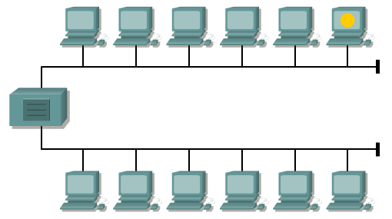
Repeater
A repeater is a network device used to regenerate a signal.
Repeaters regenerate analog or digital signals distorted by transmission loss due to attenuation.
Repeater is a Physical Layer device

Slide 7

Figure 15.2 A repeater connecting two segments of a LAN
15.<number>

Slide 8

Note
A repeater forwards every frame;
it has no filtering capability.
15.<number>

Slide 9
Note
A repeater is a regenerator,
not an amplifier.
15.<number>

Slide 10
Note
A repeater connects segments of a LAN.
15.<number>

Slide 11
Repeater
Signals that carry information within a network can travel a fixed distance before attenuation endangers the integrity of the data.
Avoid too weak or corrupted signals
Regenerates and retimes the original bit pattern.
Extend the physical length of a LAN.
Not a device that can connect two LANs of different protocols
Two-port node
Receives a frame from any of the ports, it regenerates and forwards it to the other port
Does not amplify as it cannot discriminate noise and signal
  Weakened or corrupted signal – creates copy, bit for bit at original strength
Location is vital as signal reaches it before any noise changes meaning of bit, original voltage not recoverable.
2.<number>

Slide 12

Figure 15.3 Function of a repeater
15.<number>

Slide 13
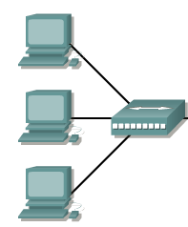
17.1.1 Active Hubs
Multiport repeater
Create connections between stations in a physical star topology
Can also be used to create multiple levels of hierarchy
17.<number>
Notes:
17.#

Slide 14

Figure 15.4 A hierarchy of hubs
15.<number>

Slide 15
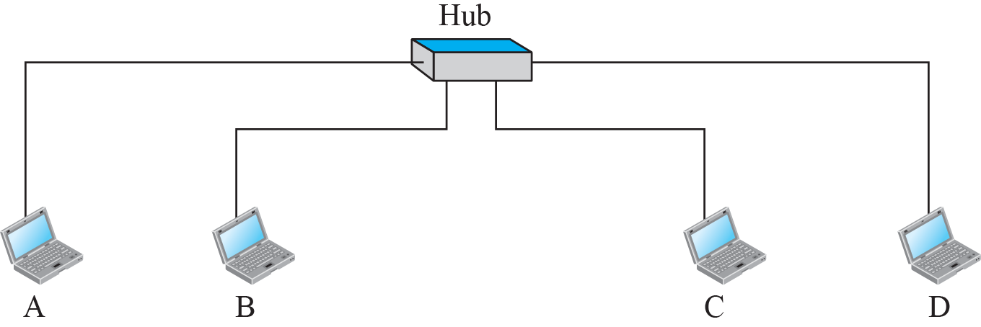
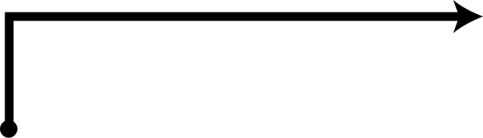

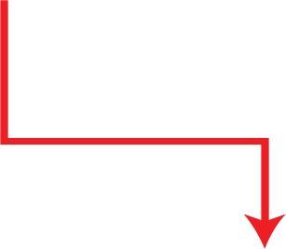



Figure 17.2: Hub
17.<number>
Notes:
17.#

Slide 16
Bridges
Regenerates the signal it receives. (PHY)
Check the physical (MAC) addresses (source and destination) contained in the frame. (DL)
Filtering capability
  Forwarded or Dropped?
  Which port to forward?
Table that maps addresses to ports
  Transparent Bridges
  Source Routing Bridges
2.<number>

Slide 17
Note
A bridge has a table used in
filtering decisions.
15.<number>

Slide 18

Figure 15.5 A bridge connecting two LANs
15.<number>

Slide 19
Note
A bridge does not change the physical (MAC) addresses in a frame.
15.<number>

Slide 20
Transparent Bridges
Stations completely unaware of bridge's existence.
IEEE 802.1 d specification
  Frames must be forwarded from one station to another
  The forwarding table is automatically made by learning frame movements in the network
  Loops in the system must be prevented
Learning Process
  Static Entries
  Dynamic Table
2.<number>

Slide 21

Figure 15.6 A learning bridge and the process of learning
15.<number>

Slide 22
Transparent Bridges – Looping Problem
Problem - redundant bridges bet pair of LANS ?
  Reliability?
Each frame is handled separately because bridges
  2 Nodes on a network sharing the medium, use an access method such as CSMA/CD
In each iteration, there are newly generated fresh copies of the frames
Bridges use the spanning tree algorithm to create a loopless topology.
2.<number>

Slide 23
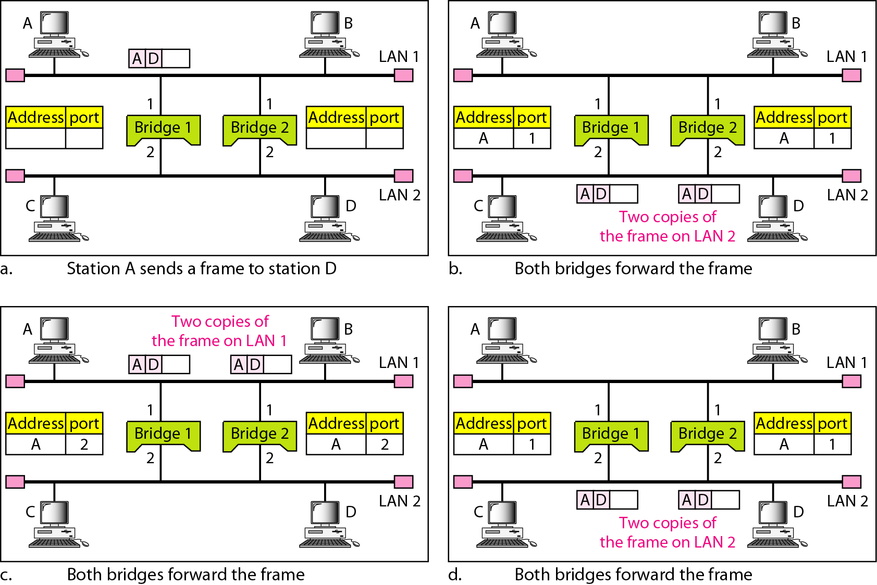
Figure 15.7 Loop problem in a learning bridge
15.<number>

Slide 24
Spanning Tree Algorithm
Broadcast Storms
  Frames Flooding bringing down entire network
Each LAN to reach other LAN thro one path only
IEEE 802.1 Committee
  Spanning Tree
  Automatically Disabling Bridges (Logical Topology)
  Not Physical Change
Requirements
  Unique Bridge ID
  Each port in Bridge – Unique Port ID
2.<number>

Slide 25
Spanning Tree Algorithm contd..
Bridge Algorithm
  Selection of Root Bridge (Lowest Bridge ID)
  Determination of Root port of Each Bridge
    Except Root Bridge
    Port with Least-Cost Path to the Root Bridge
    TIE – Choose the one with Lowest port ID
    Cost to each LAN (Ex : Higher Cost to Lower Speed LAN)
    Path Cost = Sum of Cost Along path from one bridge to Another
  Selection of Designated Bridge for each LAN
    Least Cost Path from LAN to Root Bridge
    TIE – Choose the Lowest Bridge ID
    Designated Port – Port that connects Designated Bridge and LAN
  “Forwarding State” – All Root Ports & Designated ports
  “Blocking State” – Other ports
2.<number>

Slide 26
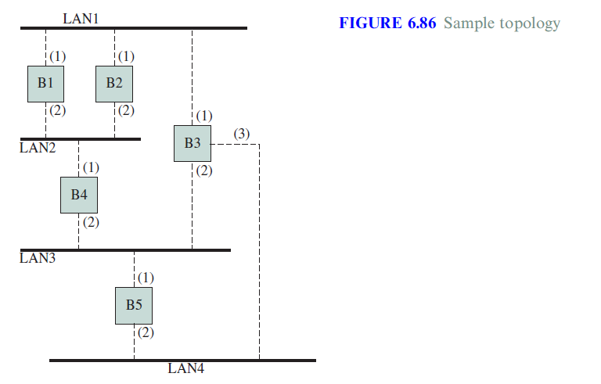
15.<number>

Slide 27
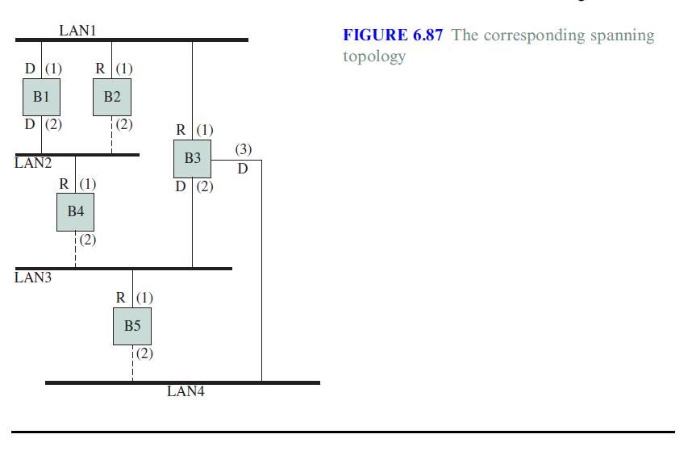
15.<number>

Slide 28
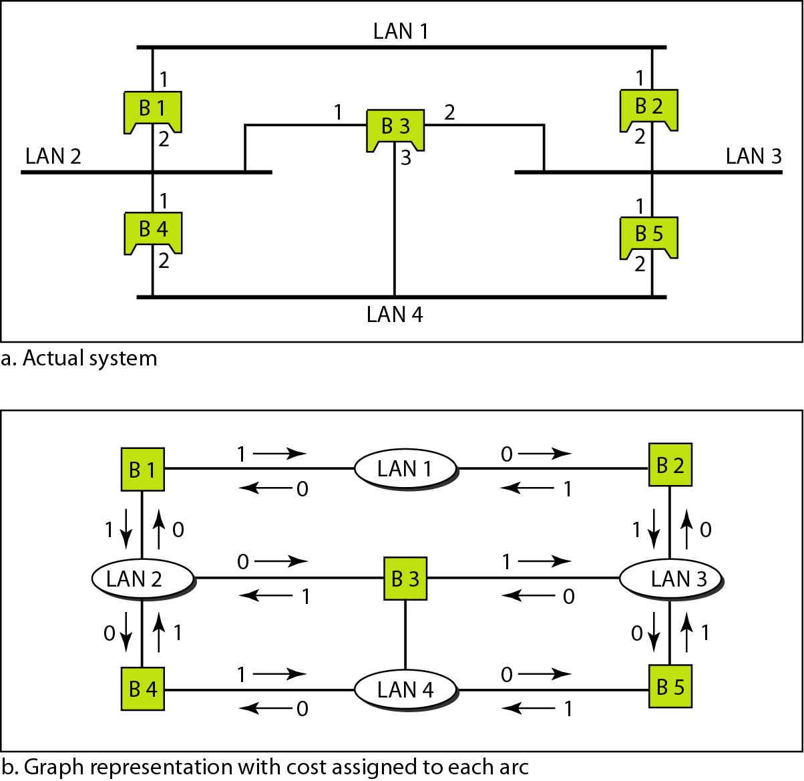
Figure 15.8 A system of connected LANs and its graph representation
15.<number>

Slide 29
Spanning Tree Algorithm
Dynamic Algorithm.
Bridges send special messages to one other
  Bridge Protocol Data Units (BPDU)
Spanning Trees are updated when there is change in system
  Failure in Bridge
  Addition/Deletion of Bridges
2.<number>

Slide 30
Source Routing Bridges
Another way to prevent loops in a system with redundant bridges.
Sending station defines the bridges that the frame must visit.
Prior to sending the data frame – Special Frame exchanges.
Ex : used in Token Ring LANs
2.<number>

Slide 31
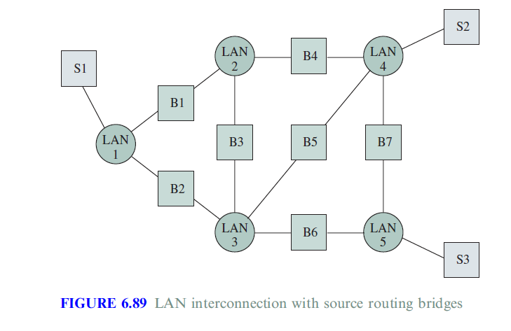
Source Routing Bridges
15.<number>

Slide 32
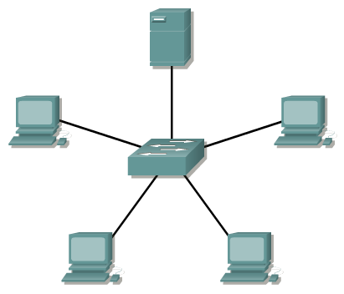
Switch
Switches are Data Link layer devices.
Connected host MAC addresses are learned and stored on a MAC address table.

Slide 33
Switching Modes
cut-through
A switch starts to transfer the frame as soon as the destination MAC address is received. No error checking is available.
store-and-forward
At the other extreme, the switch can receive the entire frame before sending it out the destination port. This gives the switch software an opportunity to verify the Frame Check Sum (FCS) to ensure that the frame was reliably received before sending it to the destination.
fragment-free
A compromise between the cut-through and store-and-forward modes.
Fragment-free reads the first 64 bytes, which includes the frame header, and switching begins before the entire data field and checksum are read.

Slide 34
Switch
Switches operate comparatively higher speeds that Bridges.
Normally a Switch has more ports than a Bridge
Method of switching
  Bridge is store and forward.
  Switch can be store and forward, cut-through or fragment-free.
Bridges can operate only in half duplex mode, but a Switch can operate both in half duplex or full duplex mode.
Packet forwarding
  Bridges are performed using software.
  Switches using ASICs (Application Specific Integrated Circuits).
2.<number>

Slide 35
17.17.3 Routers
A router is a three-layer device; it operates in the physical, data-link, and network layers.
Routes packets based on logical Addressing
Host – Host Addressing
Connects LANs and WANs in Internet
Routing Table – Dynamic - Routing Protocols
Faster Table Lookup & Forwarding
17.<number>
Notes:
17.#
17.#

Slide 36
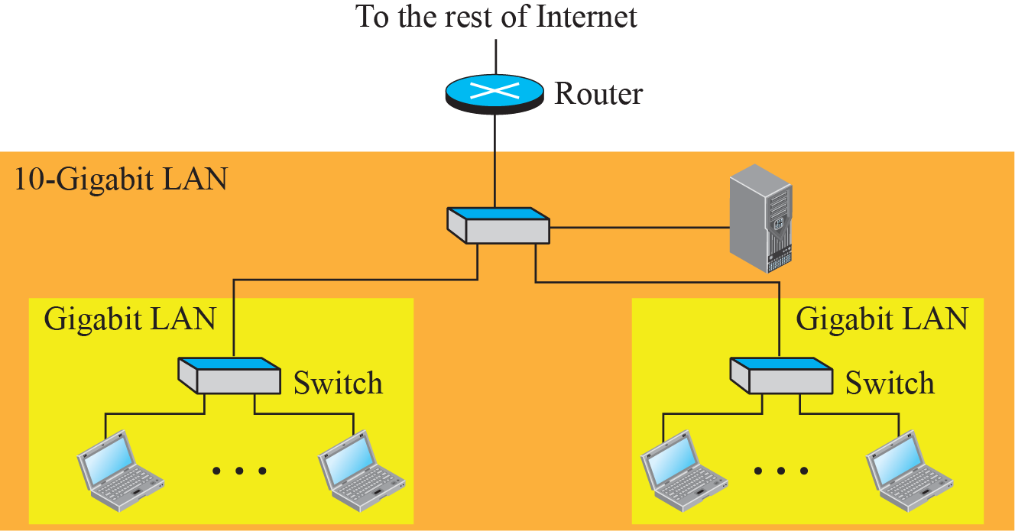
Figure 17.9: Routing example
17.<number>
Notes:
17.#

Slide 37

Figure 15.11 Routers connecting independent LANs and WANs
15.<number>

